Slide 1
Abstract
In January 2025, a CDISC working group was established to define and model Analysis Concepts, an important step toward enabling end-to-end automation within the CDISC 360i framework.
The current USDM (Unified Study Definitions Model) defines objectives, endpoints, and schedule of activities (SoA), including Biomedical Concepts (BC). While these Biomedical Concepts facilitate downstream automation of study setup and data collection, a significant gap remains in the metadata required for derived and analyzed data and their relationship to USDM-defined endpoints. As USDM currently supports eProtocol creation, a natural extension toward supporting the electronic Statistical Analysis Plan (eSAP) is required.
This presentation will provide a status update on the working group's progress in describing use cases, defining and modelling Analysis Concepts, highlighting key developments and future directions in this standardization effort.

Slide 2
Analysis Concepts definition – Initial perspectives from the CDISC working group
Kirsten Walther Langendorf / Partner at data4knowledge
15-MAY-2025

Slide 3
Analysis Concepts definition – Initial perspectives from the CDISC working group
Kirsten Walther Langendorf / Partner at data4knowledge
15-MAY-2025

Slide 4

Meet the Speaker
Kirsten Walther Langendorf
Title: Partner
Organization: data4knowledge ApS
20+ years’ experience in the pharmaceutical industry within programming, IT implementation & validation, process improvement, CDISC standards implementation, and statistics.
As partner at data4knowledge in Copenhagen, she has been involved in implementing various e2e metadata driven systems based on linked data technologies.
She actively contributes to the industry by volunteering with the CDISC Biomedical Concept curation team and the CDISC Analysis Concept team.
Notes:
The Session Chair will introduce you based on the information you provide on this slide.
Instructions:
1. Select one of the two ‘Meet the Speaker’ templates based upon how many presenters you have.
2. Insert a medium or high resolution professional bio photo of yourself and format it to the dimensions of the placeholder image(s).
3. Place bio photo(s) over the placeholder(s) and delete the placeholder image(s).
4. Fill in your name, title and organization in the text boxes provided.
5. Insert short bio’s in the text box provided. If the quantity of presenters does not allow adequate space for bios on the slide, delete this text and replace it with short bios of all presenters.

Slide 5
The team
Analysis Concept Working Group
Bess LeRoy CDISC
Peter Van Reusel CDISC
Chris Price Roche
Jeremy Teoh Lindus Health
Bhavin Busa Clymb Clinical
Edwin van Stein GSK
Brian Harris AstaZeneca
Karl Wallendszus Oxford University
Linda Lander CDISC
Kirsten Langendorf data4knowledge
Richard Marshall CDISC
Presenting on behalf of the team

Slide 6
Disclaimer and Disclosures
The views and opinions expressed in this presentation are those of the author(s) and do not necessarily reflect the official policy or position of CDISC.
I am presenting on behalf of the Analysis Concept Working group

Slide 7
Agenda
Background
Why do we need Analysis Concepts
Status and considerations on Analysis Concepts use case and modelling
Looking ahead

Slide 8
Background
Analysis Concept Working group

Slide 9
Statistics on the Analysis Concept Working group 😉
First meeting: 22-Jan-2025
# meetings so far: 10
Duration/meeting: 1 hr
Meet Wednesday every other week*
Current meeting participants
Bess LeRoy (CDISC – BC and ARS team)
Bhavin Busa (Clymb Clinical)
Brian Harris (AstraZeneca)
Chris Price (Roche)
Edwin van Stein (GSK)
Jeremy Teoh (Lindus Health)
Karl Wallendszus (Oxford University)
Kirsten Langendorf (data4knowledge)
Linda Lander (CDISC – BC team)
Peter Van Reusel (CDISC – CSO)
Richard Marshall (CDISC – ARS team)
Time zone | Start | End
Central European | 15:00 | 16:00
US Eastern Time | 09:00 | 10:00
India | 19:30 | 20:30
* Every week in April due to Interchange preparations

Slide 10
Why do we need Analysis Concepts

Slide 11
Today's specification of analysis
Primary analysis from CDISC pilot study*
1 | The primary analysis of the ADAS-Cog (11) at Week 24 will use the efficacy population with LOCF imputation for any missing values at Week 24.
2 | An ANCOVA model will be used with the baseline score, site, and treatment included as independent variables. Treatment will be included as a continuous variable, and results or a test of dose response will be produced. Interaction terms will not be investigated.
3 | If the test for dose response is statistically significant, pairwise comparisons among the 3 groups will be performed and evaluated at a significance level of 0.05.
Written in plain text
not machine readable
Some details are left out
often (at best) retrievable from the analysis executable program/define.xml
reason why regulators requires SAS programs to be submitted
Specifications are not software agnostic
SAS versus R syntax
different set of options
*know the document is old, but very likely the same is seen in newer documents

Slide 12
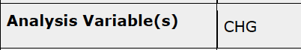
The endpoint
Primary analysis from CDISC pilot study
1 | The primary analysis of the ADAS-Cog (11) at Week 24 will use the efficacy population with LOCF imputation for any missing values at Week 24.
What was done (define.xml) versus text
CHG variable. The change from baseline at week 24 not the value at week 24
PARAMCD='ACTOT'
EFFFL='Y' and AVISIT='Week 24 – can be deduced from text

Slide 13
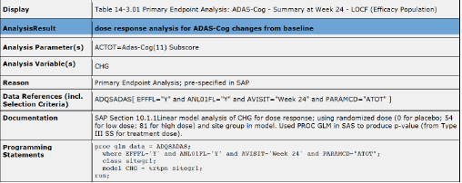
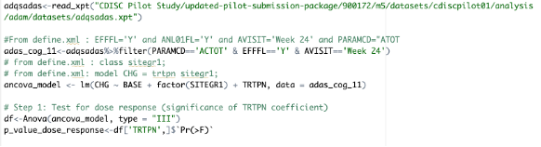
2. specifying the model in SAS – how to translate?
Primary analysis from CDISC pilot study
2 | An ANCOVA model will be used with the baseline score, site, and treatment included as independent variables. Treatment will be included as a continuous variable, and results for a test of dose response will be produced. Interaction terms will not be investigated.
From define.xml
SAS implementation
R implementation

Slide 14
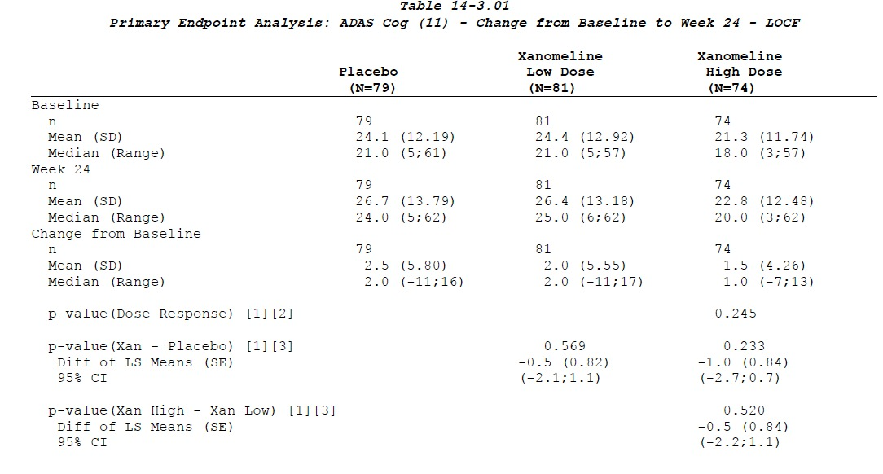
3. Pairwise estimates made – but test for DR > 0.05
Primary analysis from CDISC pilot study
3 | If the test for dose response is statistically significant, pairwise comparisons among the 3 groups will be performed and evaluated at a significance level of 0.05.
Pairwise comparison

Slide 15
We need better definitions
Reducing ambiguity
Traditional narrative statistical analysis plans can contain ambiguities that lead to different interpretations. Analysis Concepts with standardized metadata structure enforce precision in specifying analysis settings and assumptions. Analysis Concepts create a structured way to document your statistical approaches, making regulatory review more efficient and reducing queries about your methodology.
Enabling machine-readable analysis plans – automation
By structuring your analysis specifications as metadata rather than narrative text, you create machine-readable definitions that can directly link to statistical programming code. This reduces transcription errors and allows for automated validation of results against specifications.
Supporting traceability
Analysis Concepts help maintain clear linkage between protocol objectives, endpoints, and the specific analytical methods applied. This creates an audit trail showing how each study objective was addressed through specific statistical approaches.
Streamlining collaboration
Analysis Concepts provide a common language between statisticians, clinicians, data managers, and other stakeholders. The structured format helps non-statisticians understand the planned analyses without needing to interpret complex statistical notation.

Slide 16
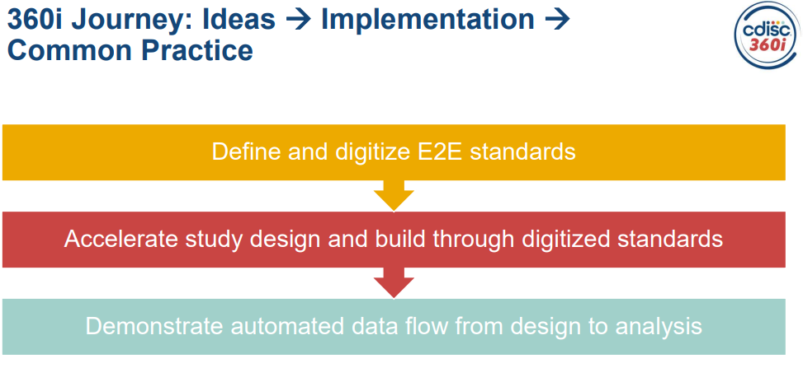
Analysis Concepts – scope of CDISC 360i
From 360i-Program-Kickoff webinar – 2025- FEB-18

Slide 17
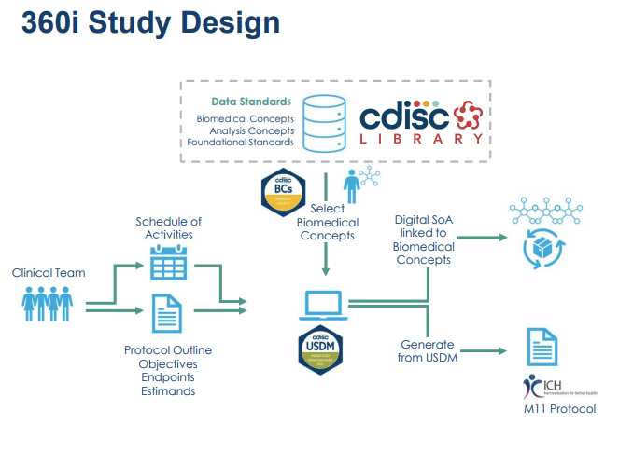
Analysis Concepts – generate eSAP
Select Analysis Concepts
Select Analysis Concepts
Analysis
eSAP?
From 360i-Program-Kickoff webinar – 2025- FEB-18
Notes:
Add the stat section in the protocol as something being generated.

Slide 18
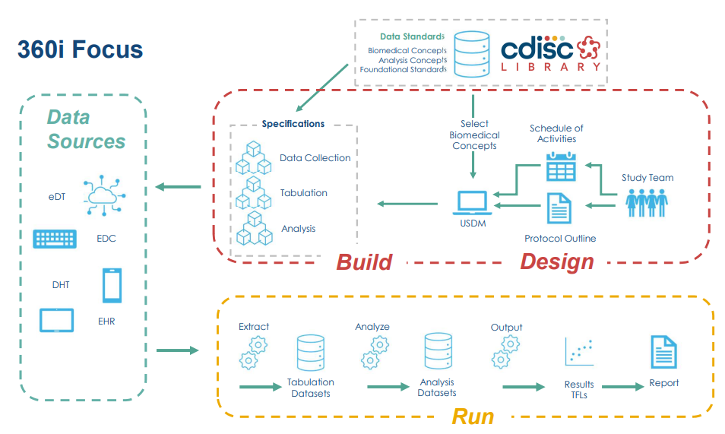
Analysis Concepts – use for downstream automation
Select Analysis Concepts
From 360i-Program-Kickoff webinar – 2025- FEB-18

Slide 19
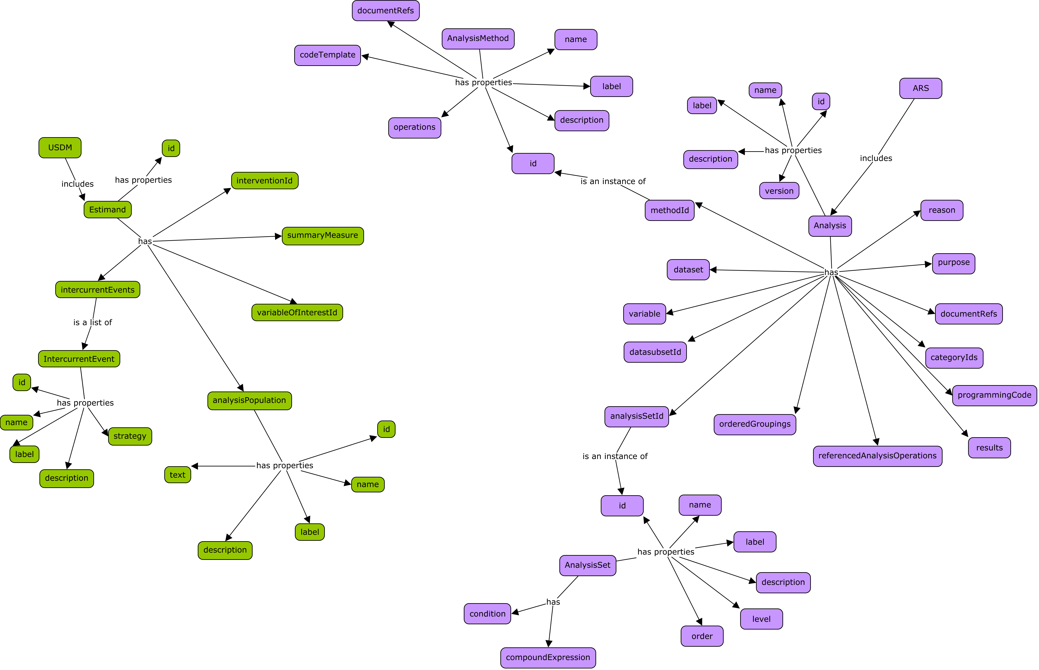
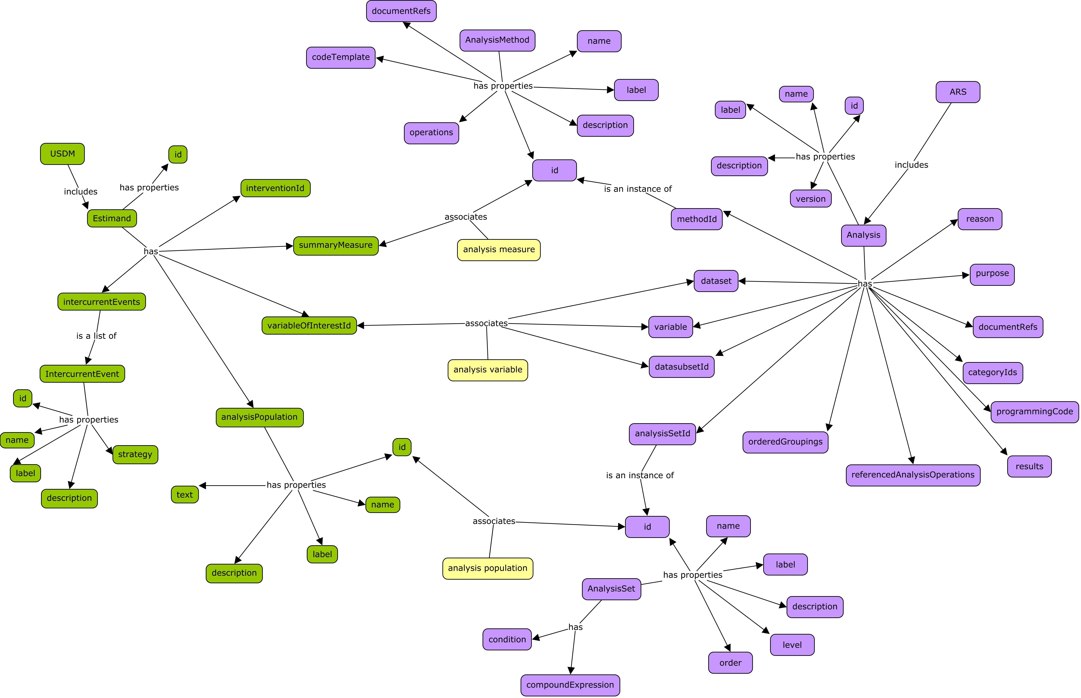
AC – the missing link between USDM and ARS

Slide 20
Status and considerations on Analysis Concepts use case and modelling

Slide 21
Use cases
as a statistician, I can define the nuances of my analyses so that a human or AI programmer can accurately implement the analyses
as a statistician, I can search for and reuse Analysis Methods
as a statistician, I can connect methods that have different implementations, different implementation contexts
as an academic, I can publish structured analysis design to journals
as a programmer, I can understand the impact analysis of changes to SAP
as a regulatory reviewer, I can understand unambiguously what analysis was done
as a statistician, I can trace from the analysis conducted to the data point which contributed to the analysis

Slide 22
AC DC
 | Analysis Concept (AC) | Derivation Concept (DC)
Purpose | Examines existing data or information to draw conclusions, identify patterns, or test hypotheses | Generates new derived values from raw or derived data
Direction | Typically works with completed measurements or observations to extract meaning | Transforms or processes data to create new representations
Process | Involves applying statistical methods, critical thinking, and interpretative frameworks to understand data | Uses mathematical operations, formulas, or algorithms to calculate new quantities
Outcome | Produces insights, conclusions, or evaluations based on the data - aggregated data (not subject-level) | Creates derived data (subject level) that serve as inputs for subsequent analysis or derivations
Example 1 | The p-value (from Type III Sums of Squares for treatment dose), based on linear model analysis of CHG for dose response; using randomized dose and site group in model. | CHG: Change from Baseline to Week 24 in ADAS Cog (11). Use LOCF is missing value at week 24.
Example 2 | Mean value of CHG by visit | CHG: Change from BASELINE in ADAS Cog (11) by visit BASELINE = 'Y' if ADAS Cog (11) at visit 2

Slide 23
Concepts in the process
Data Collection
Data Handling
Analysis Results
Analysis Display
Submission deliverables
Concepts
eDocuments
SoA
eCRF & external data
SDTM
ADaM
Analysis Data
TFLs
Biomedical Concepts
Meaning of collected data
Analysis Concepts
Analysis of data
? Concepts
Display of results
Derivation Concepts
Handling of data
eProtocol (USDM)
eSAP(USDM?)
source: reproduced from similar slide made by Edwin van Stein, PhUSE SDE, Utrecht 2025

Slide 24



Concepts in the process – analysis data rendered for different displays
Data Collection
Data Handling
Analysis Results
Display template
Submission deliverables
Concepts
eDocuments
SoA
eCRF & external data
SDTM
ADaM
Analysis Data
Biomedical Concepts
Meaning of collected data
Analysis Concepts
Analysis of data
Derivation Concepts
Handling of data
eProtocol (USDM)
eSAP(USDM?)
source: reproduced from similar slide made by Edwin van Stein, PhUSE SDE, Utrecht 2025

Slide 25
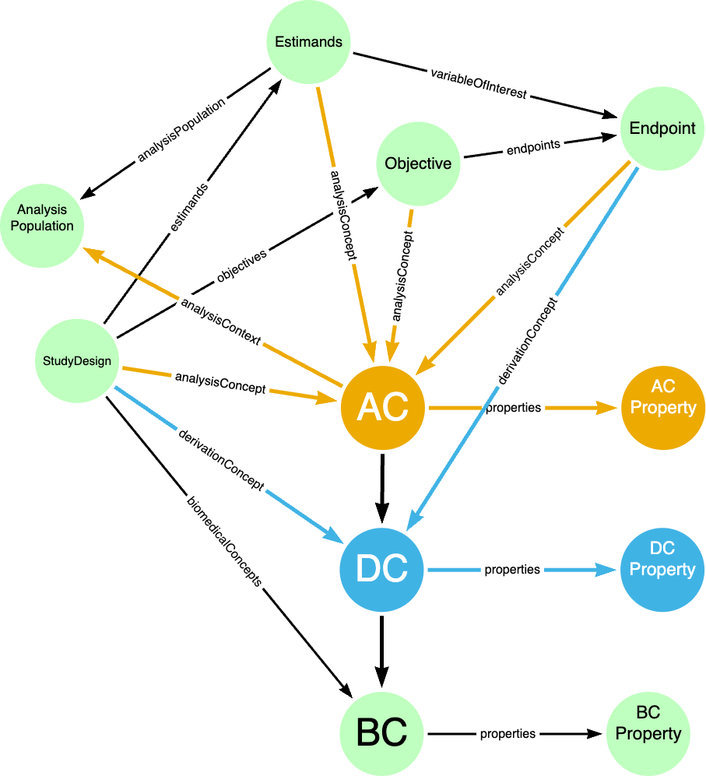
AC Basic model – like BC in USDM

Slide 26
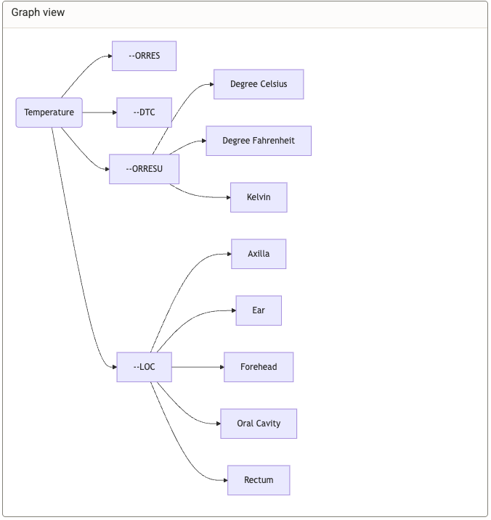
What kind of properties for AC?
BC and types of properties example
STATO stat ontology

Slide 27
Structuring the analysis text
The primary analysis of the ADAS-Cog (11) at Week 24 will use the efficacy population with LOCF imputation for any missing values at Week 24.
An ANCOVA model will be used with the baseline score, site, and treatment included as independent variables.
Treatment will be included as a continuous variable, and results for a test of dose response will be produced.
Interaction terms will not be investigated.
The primary analysis of the [ADAS-Cog (11)] at [Week 24] will use the [efficacy population] with [LOCF imputation] for any missing values at Week 24.
An [ANCOVA model] will be used with the [baseline score], [site], and [treatment] included as independent variables.
Treatment will be included as a [continuous variable], and results for a [test of dose response] will be produced.
[Interaction terms will not be investigated].

Slide 28
Statistical Analysis Mapping Table - example
The primary analysis of the [ADAS-Cog (11)] at [Week 24] will use the [efficacy population] with [LOCF imputation] for any missing values at Week 24.
An [ANCOVA model] will be used with the [baseline score], [site], and [treatment] included as independent variables.
Treatment will be included as a [continuous variable], and results for a [test of dose response] will be produced.
[Interaction terms will not be investigated].
Tagged Text | AC Parent Property | AC Child Property | AC Property Detail/Reference | Value
ADAS-Cog (11) | analysisDefinition | dependentVariable | referencedBiomedicalConcepts.label | "ADAS-Cog (11)"
Week 24 | analysisContext | timingReference | usdmTimelineElements.label | "Week 24 Visit"
efficacy population |  | analysisPopulation | label | "Efficacy Population"
LOCF imputation | analysisDefinition | missingDataHandling | method | "LOCF"
ANCOVA model |  | statisticalMethod | label | "analysis of covariance"
baseline score |  | independentVariables | label | "Baseline ADAS-Cog (11) score"
site |  | independentVariables | label | "Trial site"
treatment |  | independentVariables | label | "Treatment dose"
continuous variable |  | independentVariables | type | "continuous"
test of dose response |  | modelSpecification | inferentialTargets.label | "Dose response test"
Interaction terms will not be investigated |  | modelSpecification | constraints.description | "No interaction terms will be investigated"

Slide 29
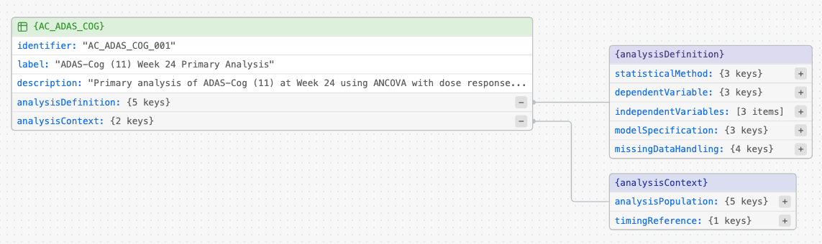
Could the AC look like this?

Slide 30
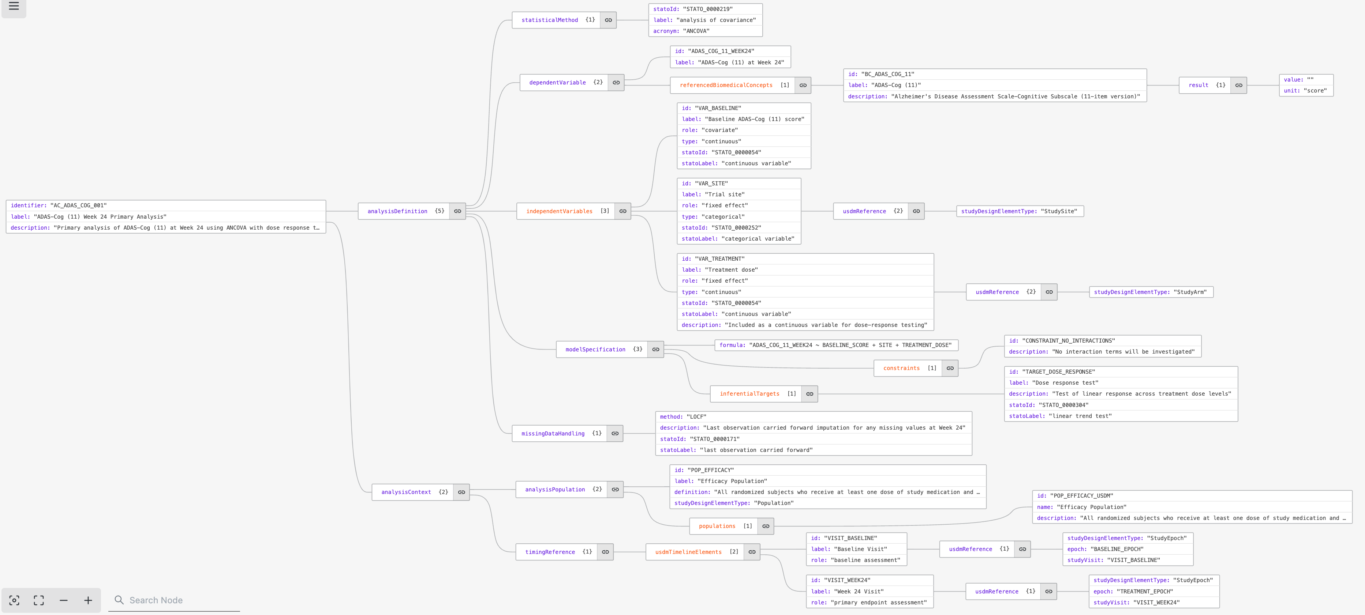
Could the AC look like this – expanding details?

Slide 31
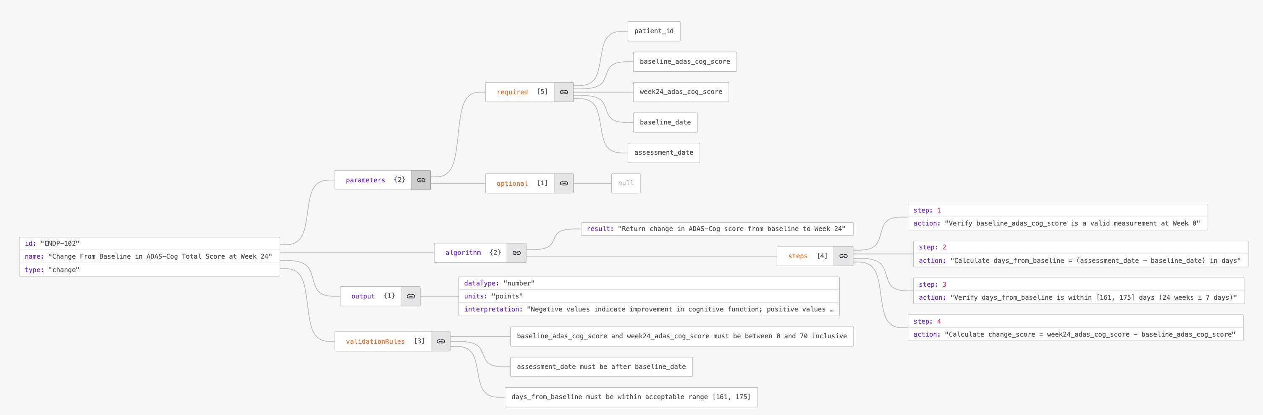
Could the DC look like this?

Slide 32
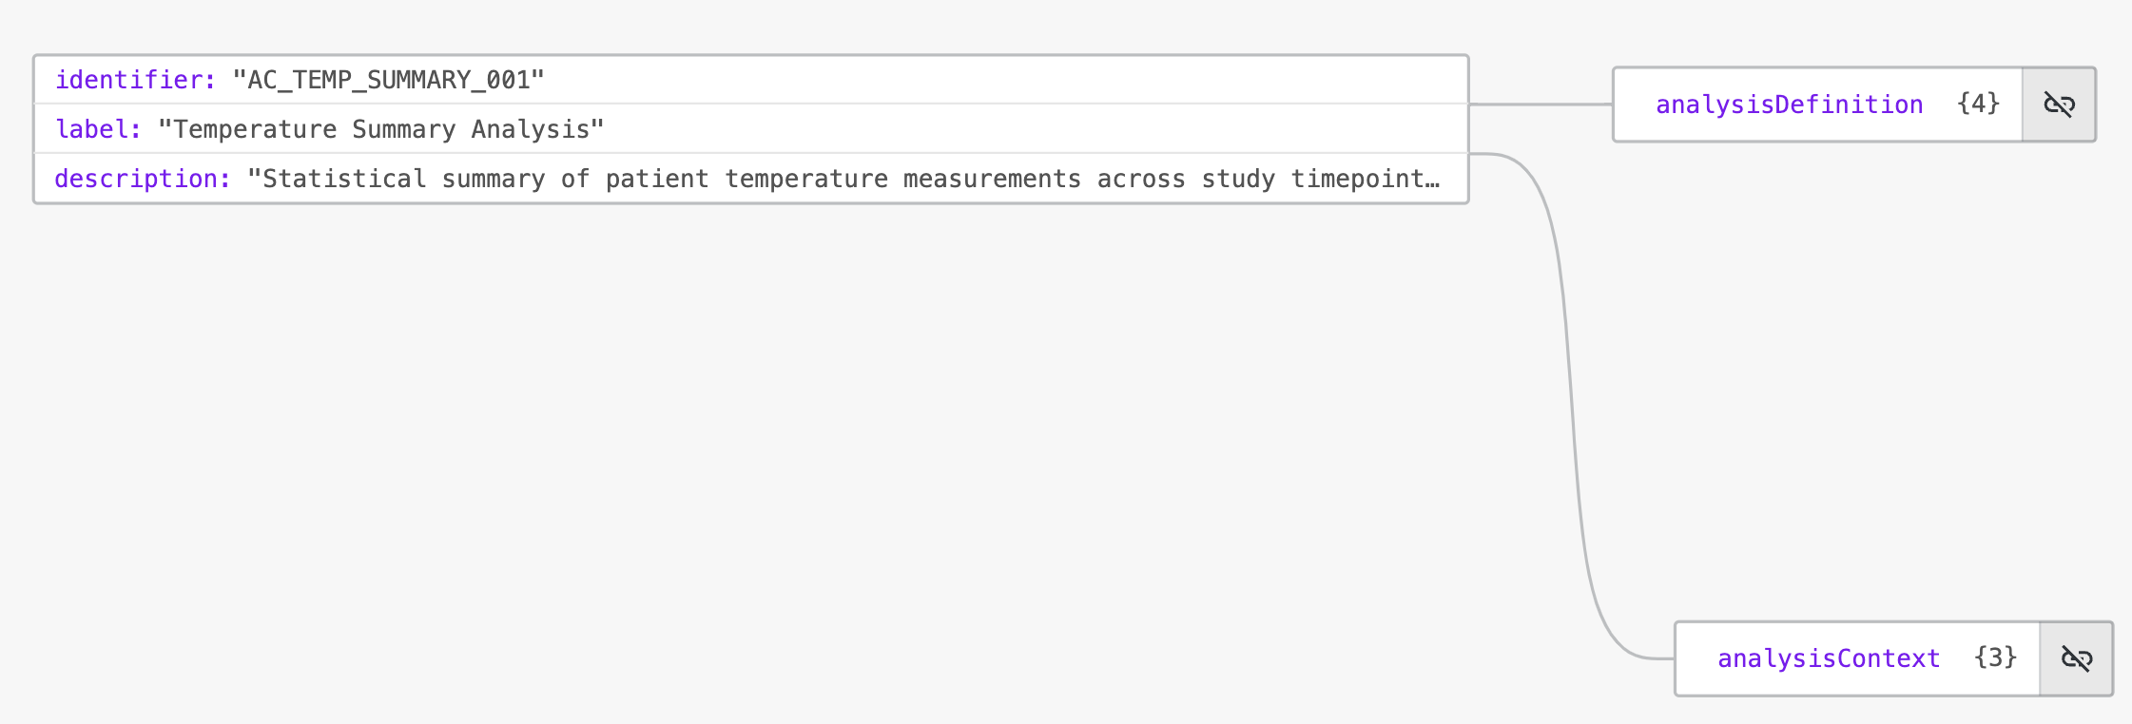
Example – Summary analysis

Slide 33
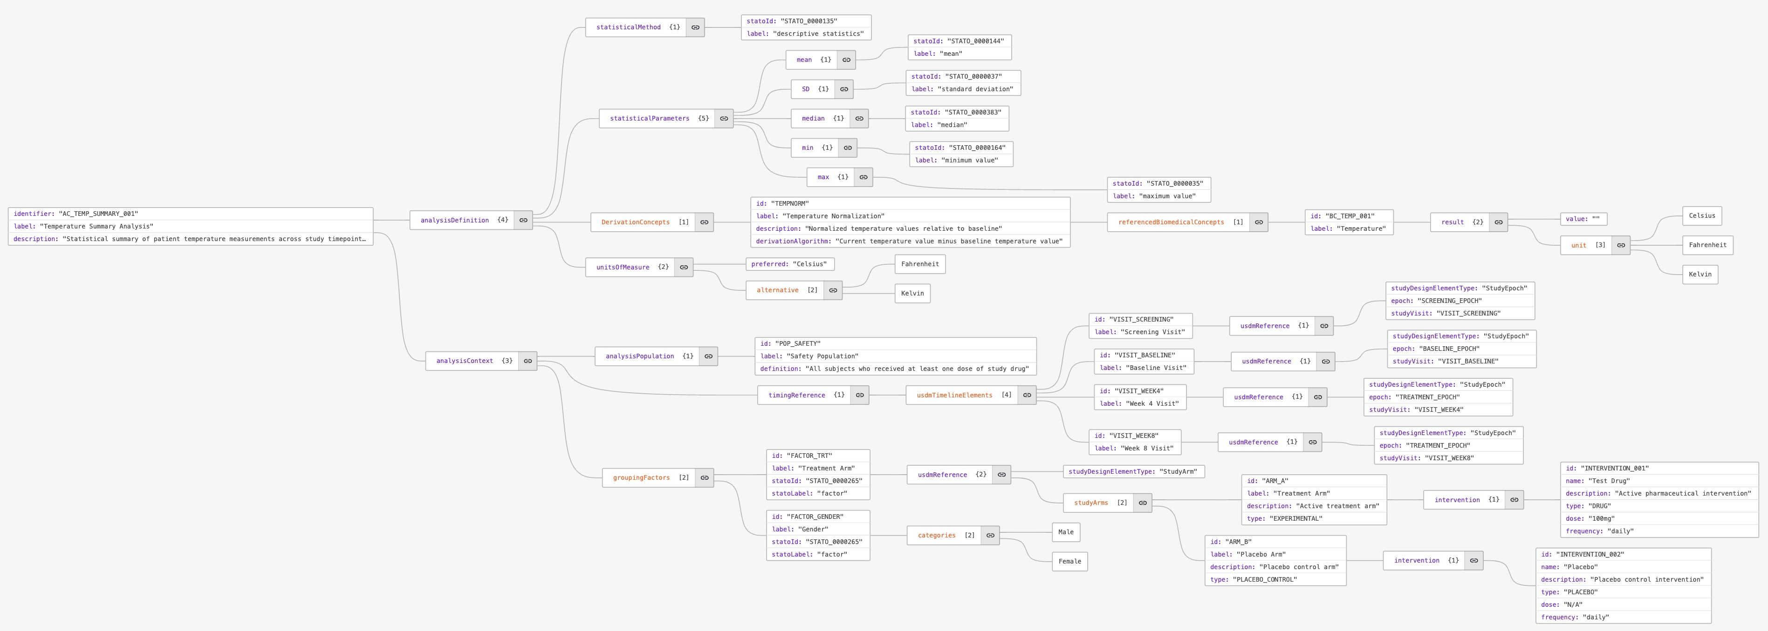
Example – Summary analysis

Slide 34
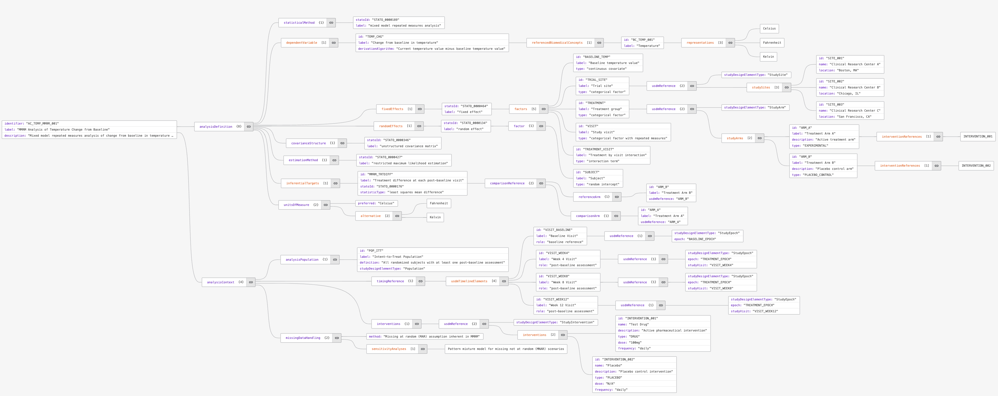
Example – MMRM analysis

Slide 35
Looking ahead

Slide 36
Work ahead of us
We need to work more on the AC model
Which structure and properties
How does it fit into USDM
Endpoint
Objective
Estimands
How does it fit with ARS
We should consider how we can 'templify' the ACs, since an analysis could be applied for many different endpoints
User will use a template and 'configure' it for study level
We need to make a PoC (360i) for a USDM study with BC -> DC ->AC
We have not touched how derivations concepts are to be defined
How can we make the flow executable
We need to investigate how/if to make eSAP

Slide 37
Thank You!
Contact:
Bess LeRoy bleroy@cdisc.org

